Slide 1

Business Support Facility for Resilient Agricultural Value chains
The Cashew Matching Grant Fund
Technical Session

Slide 2

Content
1. Climate Change
Overview information on climate change
  Mechanism of climate change;
Principles for adaptation :
  Definition and adaptation options,
  who acts and how,
  systematic and strategic approach to adaptation
2. Key Performance indicators
3. Gender Transformative approach

Slide 3
Greenhouse effect
It is a natural phenomenon without which there would be no life on earth !!!!!

Slide 4
The carbon cycle: stocks and fluxes
Through changes in land use and burning of fossil fuels, the natural carbon cycle is being disturbed; leading to more greenhouse gas emissions;
increased greenhouse effect causes global warming and significant impacts on human well-being and ecological sustainability as well as economic activities.
Global greenhouse gas emissions by sector

Slide 5
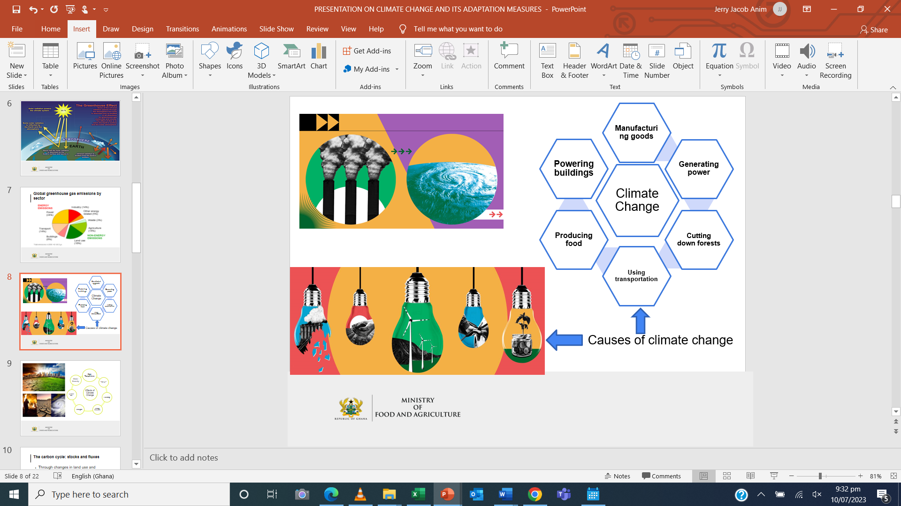
Major causes of climate change

Slide 6
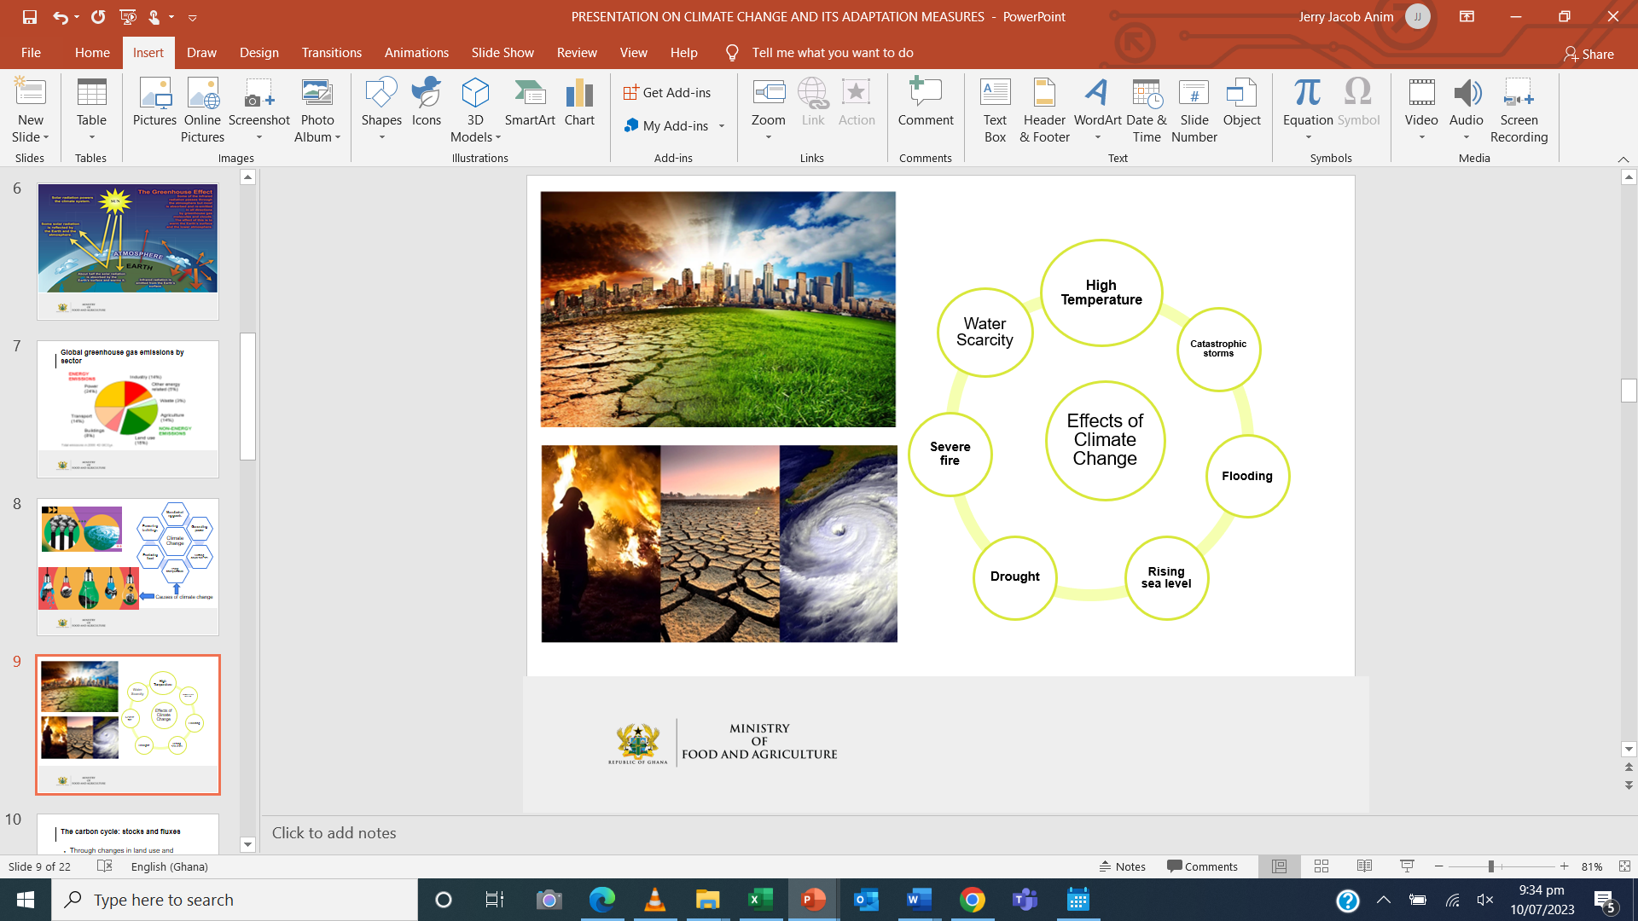
Major causes of climate change

Slide 7
Definitions
Global climate change: change in mean global temperature, changes in regional temperature, rainfall, pressure, circulation, etc.
Adaptation is an adjustments in human and natural systems, in response to actual or expected climate stimuli or their effects, that moderate harm or exploit beneficial opportunities.
Adaptation reduces vulnerability to CC impacts, reduce losses
Mitigation reduces emissions, reducing magnitude of CC
Adaptation and mitigation are complementary strategies

Slide 8
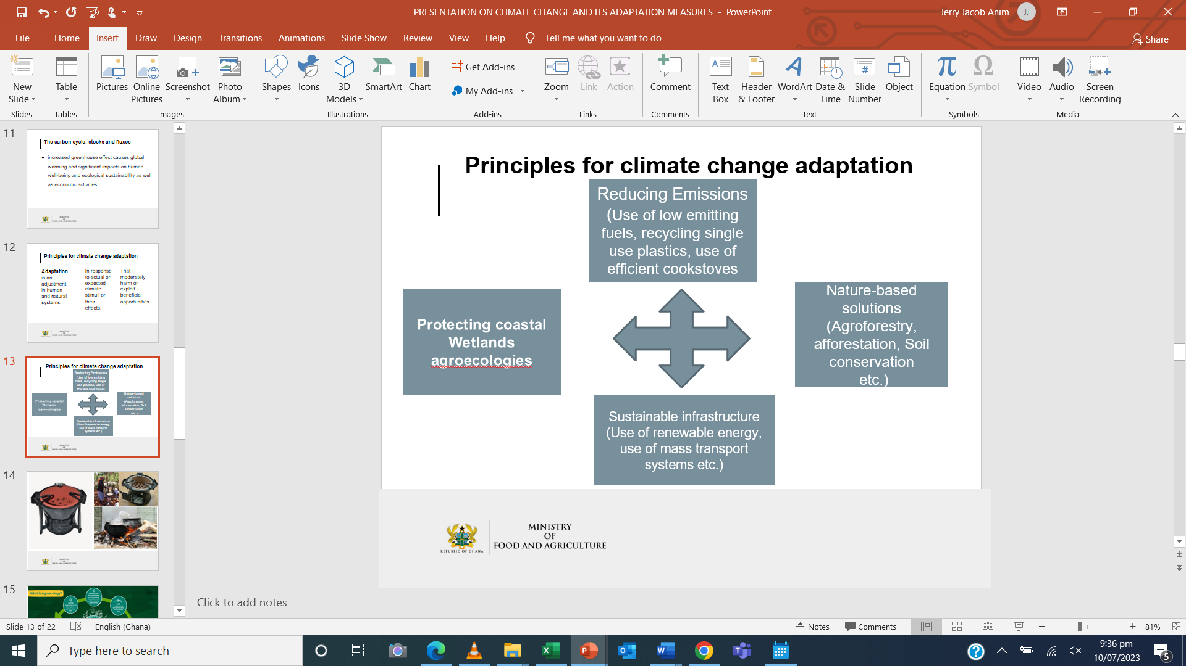
Climate Change Adaptation

Slide 9
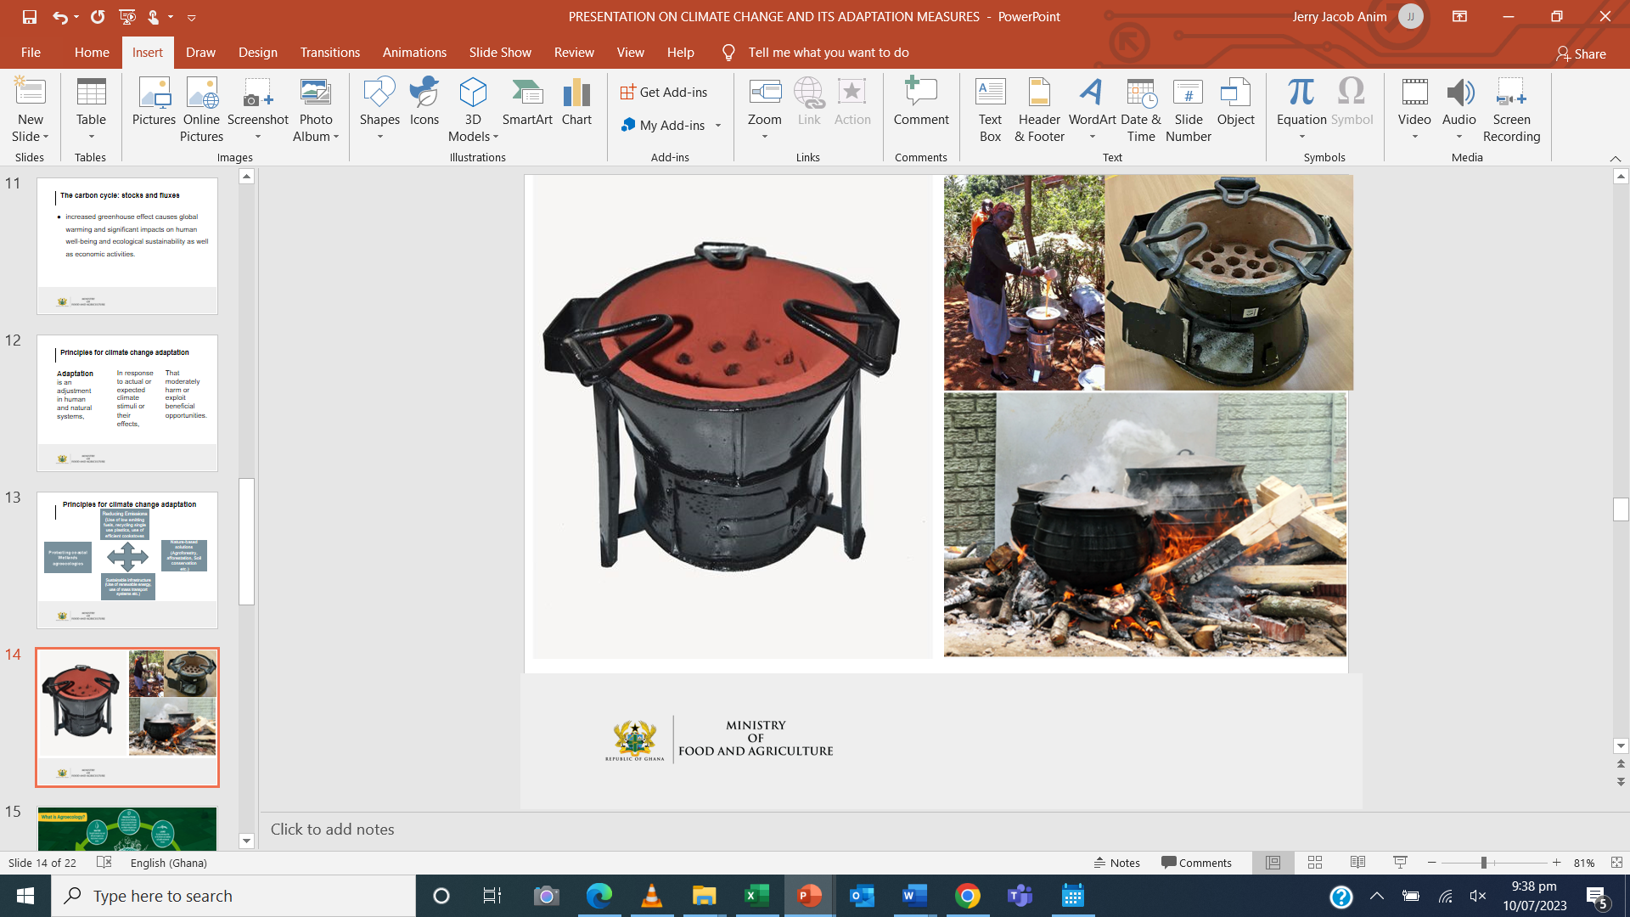
Climate Change Adaptation

Slide 10
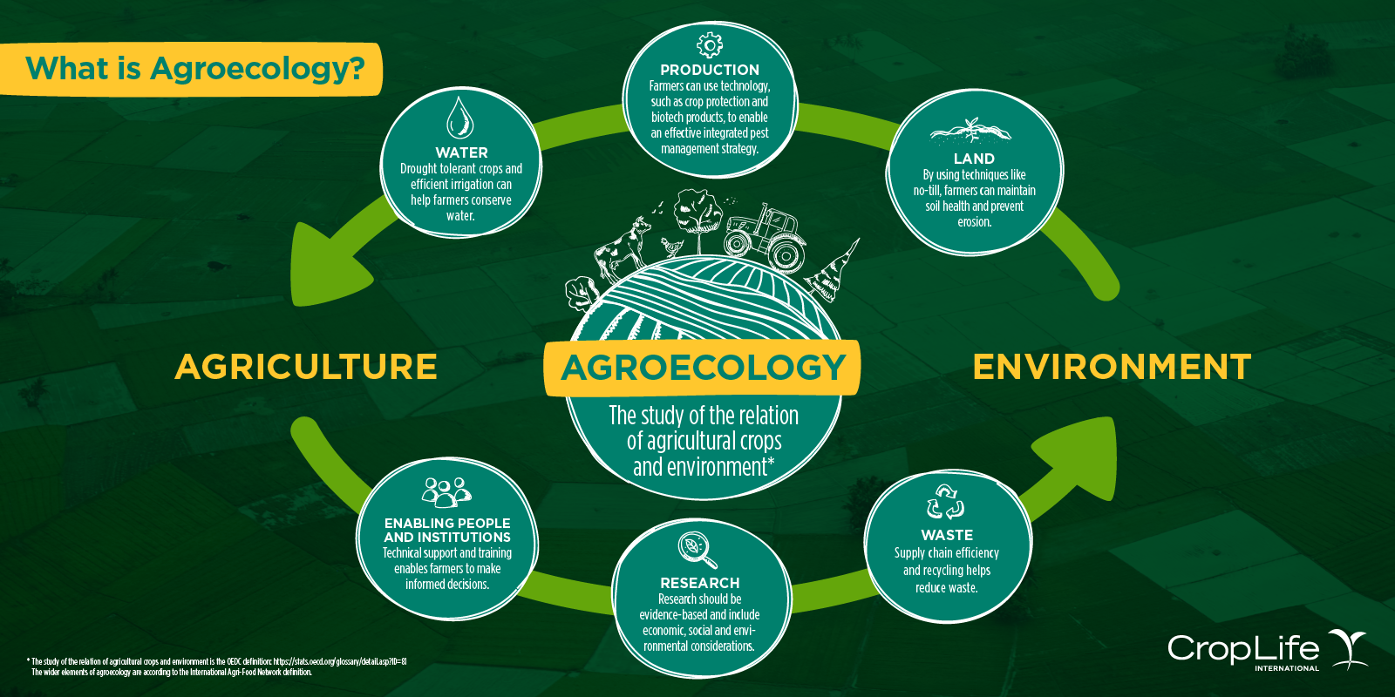
Climate Change Adaptation

Slide 11
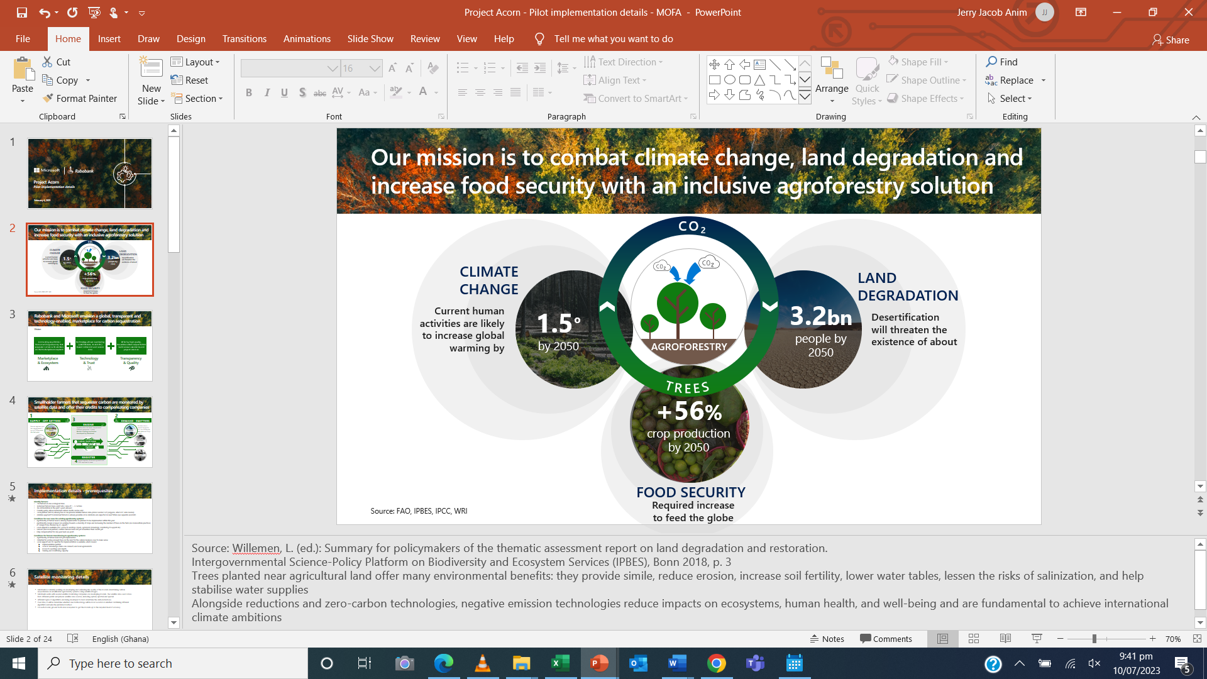
Climate Change Adaptation
Combating climate change, land degradation and increase food security with an inclusive agroforestry solution

Slide 12
What is Agroforestry ?
The integration of trees and crops on the same land management unit. Its purpose is to produce food, wood, fibre and at the same time ensures the conservation of land resource
Is a land -use system in which trees and/ shrubs are part of the farming system whether they are deliberately left in the field or actively planted.

Slide 13
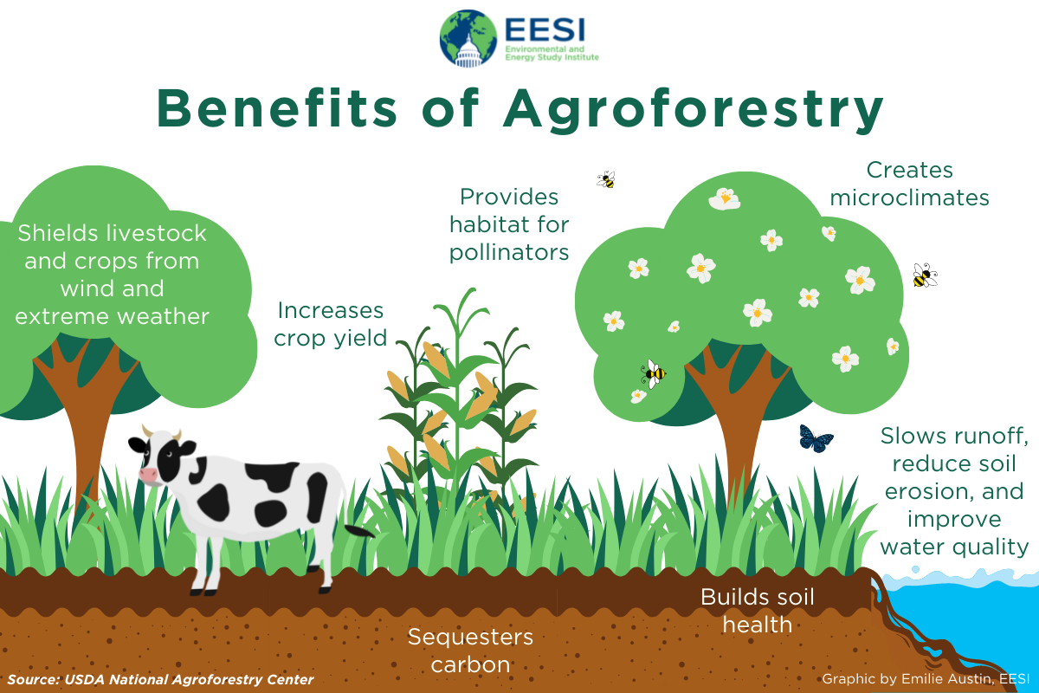
Benefits of Agroforestry

Slide 14
What are other adaptation options?
Policy
Improve regulations, adjust incentive system, enhance participation of affected com
Infrastructure
Water control – construct dykes, improve climate-resilient infrastructure
Capacity Development
Improve monitoring of sea temperature, erosion rates; improve management skills
Research
Monitoring for policy advise, climate-resilient breeds/species
Good Practices
Soil conservation, to improve agricultural yields, keep ecosystem functions intact

Slide 15
Who acts and how?
Public sector responsibilities: setting rules and regulations for public assets, public services, public goods, social protections, preventing conflict and managing migration
Individuals and communities: household preparedness, autonomous adaptation, share losses
Private Sector: Integrate climate risks into project design and services (climate-resilient investments)
International Cooperation: Financial responsibility, Resilient ODA, Capacity development

Slide 16
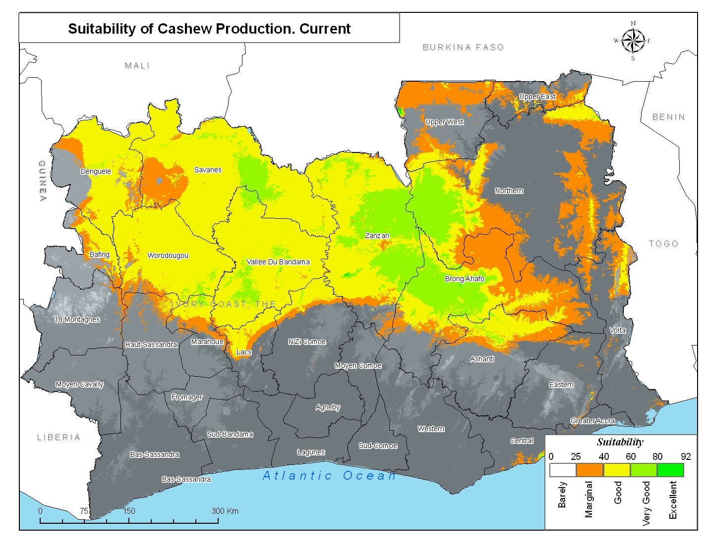
Cashew Case Study: Current

Slide 17
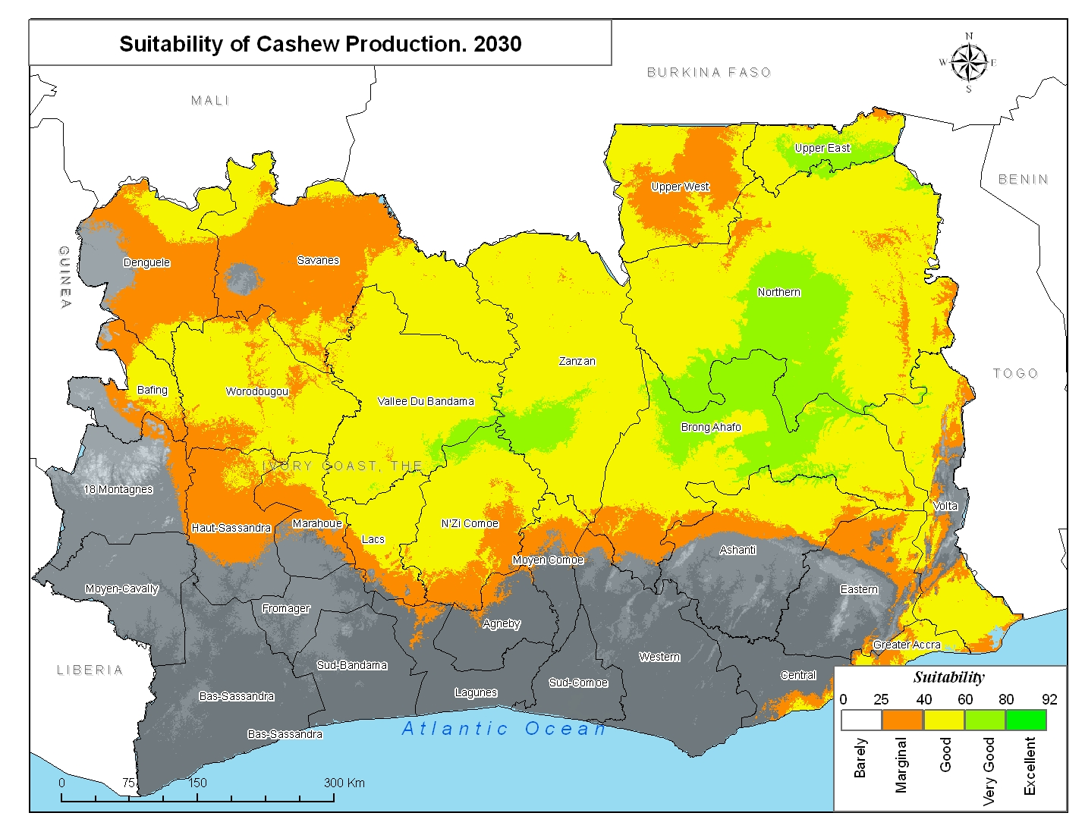
Cashewh Case Study: 2030

Slide 18
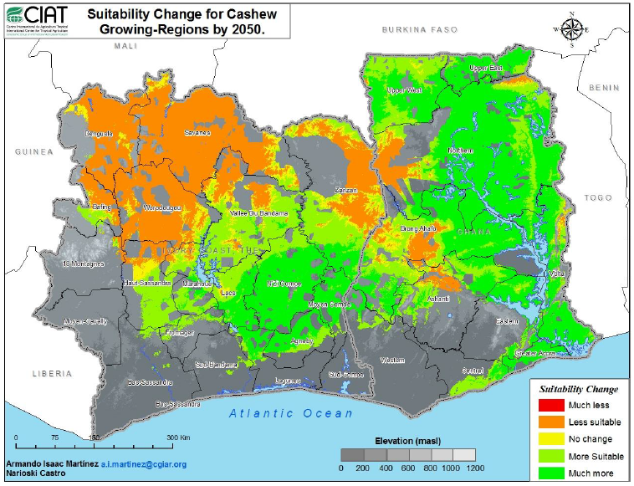
Cashewh Case Study: 2050

Slide 19
Keys opportunities
Cashew could be important to maintain thousands of livelihoods
Cultivation on areas unsuitable for other crops
Can substantially contribute to food security
Increase of yield and quality by implementing new technologies (germplasm)
Several uses of the fruit (juice, fuel, etc.)
Environmental services (reforestation, + feedback on climate, cc mitigation)

Slide 20
Examples of Climate Change practices in relation to Cashew VC
Intensification to prevent new infiltration in forest reserve
Use of cashew shells for briquets
Intercroping and use of cover crops for soil fertility
Use of renewable energy
Reforestation/Rehabiltaion of degraded lands
Promotion of climat Smart Practices
Mulching & Drip Irrigation
Carbon Credit
Sustainable Supply Chain Linkage (Sourcing at Origin)
Beekeeping/ Conservation Biodiversity
Conservation Agriculture & Agroforestery
Certification (Bio, Rainforest alliance, etc.)
Drought, pest and disease tolerant planting material
Cashew Apple Processing

Slide 21
Key Performance Indicators
Income & turnover
Average increased income of supplying agricultural MSME
Turnover of producer organisations from services provided to their members
Turnover in processing
Climate Resilience & Gender
Contribution to climate resilience (adaptation and/or mitigation/CO2 reduction and/storage)
Strengthening women and youth, who should make up 50% of the proposed intervention each, in access to resources, to education, to business opportunities & linkages, investment-related decision making and finance
Job creation & producer organisations
Jobs created in primary production.
Jobs created in processing.
Jobs created in services (technical, digital, financial services)
Increase member base of producer organisations (increase, mergers, unions)

Slide 22
Other Performance Indicators
Food security and export
Contribution to food security via supply of food (products) to markets
Contributions to substitute imports of food products or of ingredients for (food) industry
Foreign currency earnings from export
Other Innovation Indicators
Innovation in primary production
Innovation in processing for process optimization, efficiency and quality efficiency in processing and technology
Innovation in technology development
Innovation in technical services
Innovation in digital services
Innovation in business services (information on markets & finance, buyers,
Scaling of evidence-based approaches / technologies, innovations
Consolidated sourcing base

Slide 23
Gender Transformative Approach
GTA is different from the other gender related approaches in development which simply address the symptoms of gender-based inequality rather than its underlying causes.

Slide 24
Gender Transformative Approach
GTA aims to change the root causes of gender-based inequality and reshape unequal power relations:
Existing power dynamics
Existing power structures
Norms (social, cultural, religious)
Beliefs
Attitudes

Slide 25
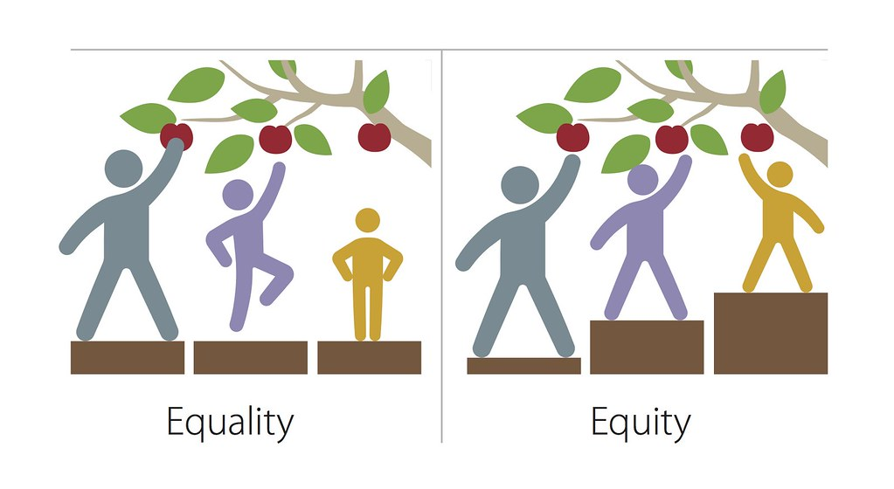
Definitions
(https://live.staticflickr.com/715/31655988501_979c7b1c82_b.jpg)
Notes:
Gender equality contributes to national, political, economic, social & cultural development & benefits from the results.

Slide 26
GTA in the MOVE programme interventions
Addressing practical gender needs (e.g. knowledge, skills, access to productive resources)
Strategic gender interests (e.g. decision-making power, position/status in society) by triggering changes in agency, social relations and social structures
Social relations (Power relations in the household, groups, networks, etc)
Social structures (norms, customs, practices, laws, policies, services)
Building Agency (confidence, self-esteem, knowledge, skills & capacities)

Slide 27
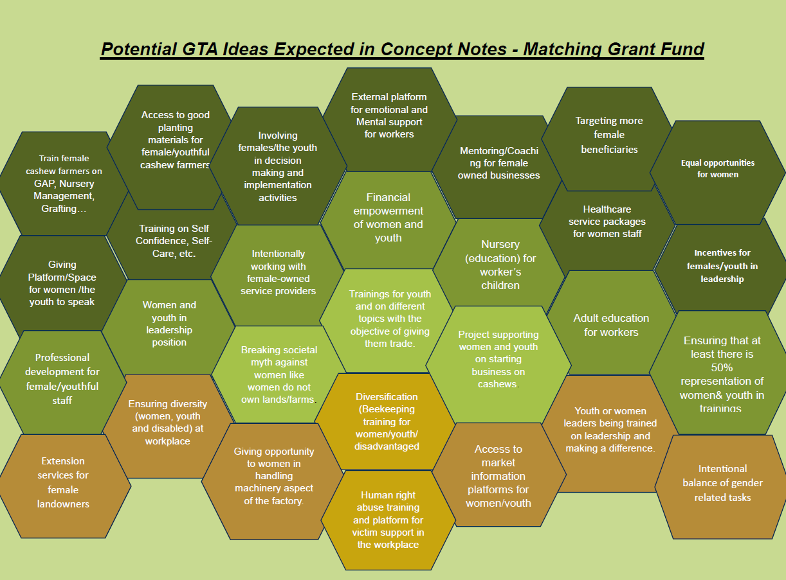
Potential GTA Ideas expected in Concept notes

Slide 28
THANK YOU

